Slide 1
CIS117 Week 12
Scripts with Loops

Slide 2
What is a loop
Loop takes care of repetitive tasks
Not the same as if/else or case statements
Use cases
Move or delete files over a certain size/age/attribute
Number manipulation (such as increase all numbers by 1)
Changing whole folders of files (such as adding time stamps or changing permissions)
Searching for a value
Check computer status (such as is the server up)

Slide 3
While
While runs as long as condition is successfully executing, stops when condition is false
Uses
Counting
Reading input

Slide 4
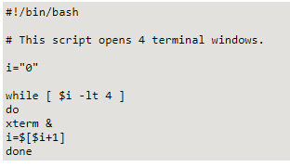
While loop example
http://tldp.org/LDP/Bash-Beginners-Guide/html/sect_09_02.html

Slide 5
until
Only runs when condition is false or command fails
Uses
Sequence
Input

Slide 6
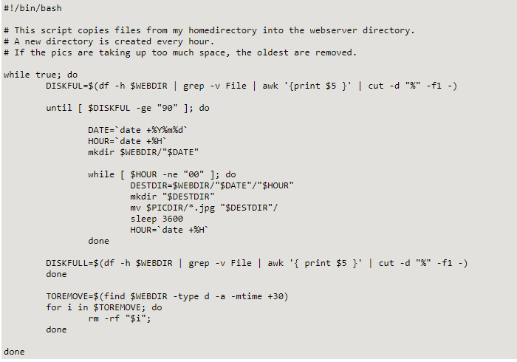
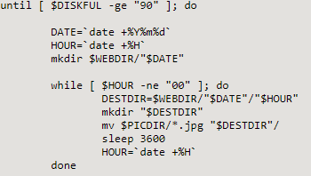
Complex until loop example
http://tldp.org/LDP/Bash-Beginners-Guide/html/sect_09_03.html

Slide 7
for
Also called a for-each
Uses
Process list of items
Sequence
Items from another command (such as cat or ls)

Slide 8
For loop example
https://www.cyberciti.biz/faq/bash-for-loop/

